Slide 1
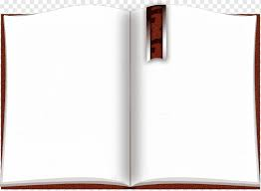
What is Constitution?
The organic and fundamental law of a nation or state, setting forth its organizing principles, operating structures, limitations of powers of the component parts, and setting the extent and nature of sovereign powers.

